Slide 1
PATH EADUCATION (pvt). Ltd

Slide 2
Table of Content
Structure of Operating System
The Function of Operating System

Slide 3
Structure of Operating System
Operating system can be implemented with the help of various structures. The structure of the OS depends mainly on how the various common components of the operating system are interconnected and melded into the kernel. Depending on this we have following structures of the operating system:
Simple structure
Layered structure
Micro-kernel
Modular structure or approach

Slide 4
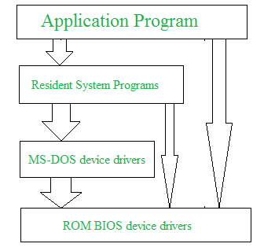
Simple structure
Such operating systems do not have well defined structure and are small, simple and limited systems. The interfaces and levels of functionality are not well separated. MS-DOS is an example of such operating system. In MS-DOS application programs are able to access the basic I/O routines. These types of operating system cause the entire system to crash if one of the user programs fails.
Diagram of the structure of MS-DOS is shown below.

Slide 5
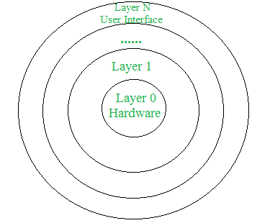
Layered structure
An OS can be broken into pieces and retain much more control on system. In this structure the OS is broken into number of layers (levels). The bottom layer (layer 0) is the hardware and the topmost layer (layer N) is the user interface. These layers are so designed that each layer uses the functions of the lower level layers only. This simplifies the debugging process as if lower level layers are debugged and an error occurs during debugging then the error must be on that layer only as the lower level layers have already been debugged.
The main disadvantage of this structure is that at each layer, the data needs to be modified and passed on which adds overhead to the system. Moreover careful planning of the layers is necessary as a layer can use only lower level layers. UNIX is an example of this structure.

Slide 6
Micro-kernel
This structure designs the operating system by removing all non-essential components from the kernel and implementing them as system and user programs. This result in a smaller kernel called the micro-kernel.
Advantages of this structure are that all new services need to be added to user space and does not require the kernel to be modified. Thus it is more secure and reliable as if a service fails then rest of the operating system remains untouched. Mac OS is an example of this type of OS.

Slide 7
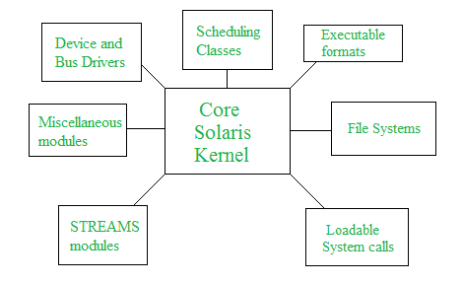
Modular structure or approach
It is considered as the best approach for an OS. It involves designing of a modular kernel. The kernel has only set of core components and other services are added as dynamically loadable modules to the kernel either during run time or boot time. It resembles layered structure due to the fact that each kernel has defined and protected interfaces but it is more flexible than the layered structure as a module can call any other module.
For example Solaris OS is organized as shown in the figure.

Slide 8
The Function of Operating System
Memory
The operating system manages the Primary Memory or Main Memory. Main memory is made up of a large array of bytes or words where each byte or word is assigned a certain address. Main memory is a fast storage and it can be accessed directly by the CPU. For a program to be executed, it should be first loaded in the main memory. An Operating System performs the following activities for memory management:
It keeps tracks of primary memory, i.e., which bytes of memory are used by which user program. The memory addresses that have already been allocated and the memory addresses of the memory that has not yet been used. In multi programming, the OS decides the order in which process are granted access to memory, and for how long. It Allocates the memory to a process when the process requests it and deallocates the memory when the process has terminated or is performing an I/O operation.
File
A file system is organized into directories for efficient or easy navigation and usage. These directories may contain other directories and other files. An Operating System carries out the following file management activities. It keeps track of where information is stored, user access settings and status of every file and more… These facilities are collectively known as the file system.

Slide 9
Device
An OS manages device communication via their respective drivers. It performs the following activities for device management. Keeps tracks of all devices connected to system. designates a program responsible for every device known as the Input / Output controller. Decides which process gets access to a certain device and for how long. Allocates devices in an effective and efficient way. Deallocates devices when they are no longer required.
Processor
In a multi programming environment, the OS decides the order in which processes have access to the processor, and how much processing time each process has. This function of OS is called process scheduling. An Operating System performs the following activities for processor management. Keeps tracks of the status of processes. The program which perform this task is known as traffic controller. Allocates the CPU that is processor to a process. De-allocates processor when a process is no more required.
Security
The operating system uses password protection to protect user data and similar other techniques. it also prevents unauthorized access to programs and user data.
Performance and Error Management
Operating system constantly monitors the system to detect errors and avoid the malfunctioning of computer system.

